Slide 1
Web search engines
Paolo Ferragina
Dipartimento di Informatica
Università di Pisa
Notes:
Prof. Paolo Ferragina, Algoritmi per "Information Retrieval"

Slide 2
Two main difficulties
The Web:
  Size: more than 1 trillion pages
  Language and encodings: hundreds…
  Distributed authorship: SPAM, format-less,…
  Dynamic: in one year 35% survive, 20% untouched
The User:
  Query composition: short (2.5 terms avg) and imprecise
  Query results: 85% users look at just one result-page
  Several needs: Informational, Navigational, Transactional
Extracting “significant data” is difficult !!
Matching “user needs” is difficult !!
Notes:
Prof. Paolo Ferragina, Algoritmi per "Information Retrieval"

Slide 3

The structure of a search Engine
Page archive
Crawler
Query
Web
Page
Analizer
Indexer
Query
resolver
Ranker
Which pages
to visit next?
text
auxiliary
Structure
Notes:
Paolo Ferragina, Web Algorithmics

Slide 4
The web graph: properties
Paolo Ferragina
Dipartimento di Informatica
Università di Pisa
Notes:
Prof. Paolo Ferragina, Algoritmi per "Information Retrieval"

Slide 5
The Web’s Characteristics
It’s a graph whose size is
  1 trillion of pages is available
    50 billion pages crawled (09/15)
  5-40K per page => terabytes & terabytes
  Size grows every day!!
  Actually the web is infinite… Calendars…
It’s a dynamic graph with
  8% new pages, 25% new links change weekly
  Life time of about 10 days
Notes:
Prof. Paolo Ferragina, Algoritmi per "Information Retrieval"

Slide 6
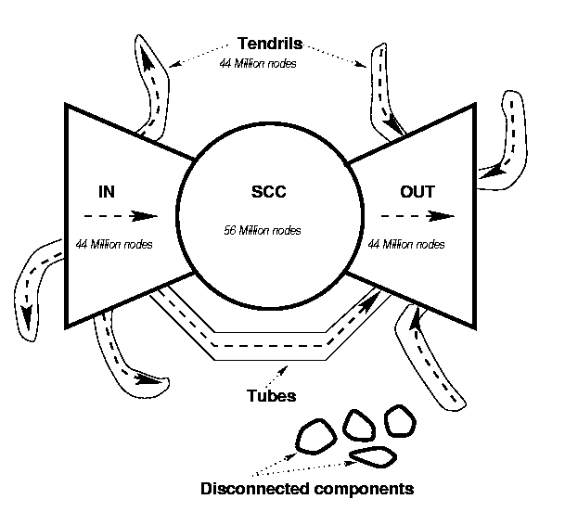
The Bow Tie
Notes:
Prof. Paolo Ferragina, Algoritmi per "Information Retrieval"

Slide 7
Crawling
Paolo Ferragina
Dipartimento di Informatica
Università di Pisa
Notes:
Prof. Paolo Ferragina, Algoritmi per "Information Retrieval"

Slide 8
Spidering
24h, 7days “walking” over the web graph
Recall that:
  Direct graph G = (N, E)
  N changes (insert, delete) >> trillion nodes
  E changes (insert, delete) > 10 links per node
    Trillion entries in posting lists
    Many more if we consider also the word positions in every document where it occurs.

Slide 9
Crawling Issues
How to crawl?
  Quality: “Best” pages first
  Efficiency: Avoid duplication (or near duplication)
  Etiquette: Robots.txt, Server load concerns (Minimize load)
  Malicious pages: Spam pages, Spider traps – incl dynamically generated
How much to crawl, and thus index?
  Coverage: How big is the Web? How much do we cover?
  Relative Coverage: How much do competitors have?
How often to crawl?
  Freshness: How much has changed?
  Frequency: Commonly insert time gap btw host requests

Slide 10

Crawling picture
Sec. 20.2
URLs crawled
and parsed
Unseen Web
Seed
pages
URLs frontier
Web

Slide 11
Updated crawling picture
Sec. 20.1.1
URLs crawled
and parsed
Unseen Web
Seed
Pages
URL frontier
Crawling thread

Slide 12
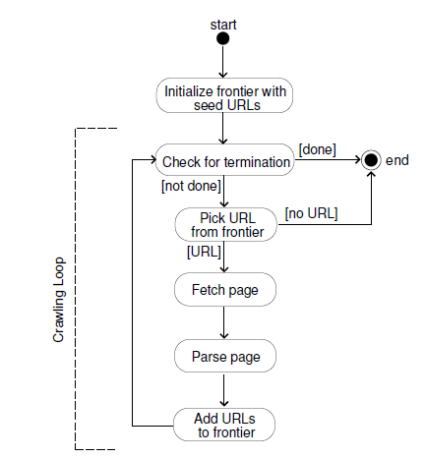
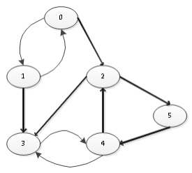
A small example
Notes:
Paolo Ferragina, Web Algorithmics

Slide 13
Crawler “life cycle”
PQ
Crawler Manager
AR
Link
Extractor
PR
Downloaders
One Link Extractor per page:
while(<Page Repository is not empty>){
<take a page p (check if it is new)>
<extract links contained in p within href>
<extract links contained in javascript>
<extract …..
<insert these links into the Priority Queue>
}
One Downloader per page:
while(<Assigned Repository is not empty>){
<extract url u>
<download page(u)>
<send page(u) to the Page Repository>
<store page(u) in a proper archive,
possibly compressed>
}
A single Crawler Manager:
while(<Priority Queue is not empty>){
<extract some URL u having the highest priority>
foreach u extracted {
if ( (u ∉ “Already Seen Page” ) ||
( u ∈ “Already Seen Page” && <u’s version on the Web is more recent> )
) {
<resolve u wrt DNS>
<send u to the Assigned Repository>
}
}
}

Slide 14
URL frontier visiting
Given a page P, define how “good” P is.
Several metrics (via priority assignment):
  BFS, DFS, Random
  Popularity driven (PageRank, full vs partial)
  Topic driven or focused crawling
  Combined
How to fast check whether the URL is new ?

Slide 15
Mercator (1999)
Sec. 20.2.3
URLs
Only one connection per host is open at a time;
a waiting time of a few seconds occurs between successive requests to the same host;
high-priority pages are crawled preferentially.
Prioritizer
K front queues (K priorities)
Biased front-queue selector
(Politeness) Back queue
B back queues (hosts)
Single host on each
Back-queue selector
Based on min-heap & priority = waiting time
Crawl thread requesting URL

Slide 16
Front queues
Sec. 20.2.3
Front queues manage prioritization:
  Prioritizer assigns to an URL an integer priority (refresh, quality, application specific) between 1 and K
  Appends URL to corresponding queue, according to priority
Prioritizer
(assigns to a queue)
1
K
Routing to Back queues

Slide 17
Back queues
Sec. 20.2.3
1
K
Back queue request → Select a front queue
randomly, biasing towards higher queues
1
B
Here, every queue is specialized to one single host, but host change…

Slide 18
Back queues
Sec. 20.2.3
Back queues enforce politeness:
  Each back queue is kept non-empty
  Each back queue contains only URLs from a single host
Back queue request → Select a front queue
randomly, biasing towards higher queues
1
B
URL selector
(pick min, parse and push)
min-Heap

Slide 19
The min-heap
Sec. 20.2.3
It contains one entry per back queue
The entry is the earliest time t_{e} at which the host corresponding to the back queue can be “hit again”
This earliest time is determined from
  Last access to that host
  Any time buffer heuristic we choose

Slide 20
The crawl thread
Sec. 20.2.3
A crawler seeks a URL to crawl:
  Extracts the root of the heap: So it is an URL at the head of some back queue q (and then removes it)
  Waits the indicated time t_{url}
  Parses URL and adds its out-links to the Front queues
If back queue q gets empty, pulls a URL v from some front queue (more prob for higher queues)
  If there’s already a back queue for v’s host, append v to it and repeat until q gets not empty;
  Else, make q the back queue for v’s host
If back queue q is non-empty, pick URL and add it to the min-heap with priority = waiting time t_{url}
Keep crawl threads busy (B = 3 x threads)

